Slide 1

Cyclistic Bike-Share Business strategies
Saulo Sanchez

Slide 2
Objectives
Find out difference between member riders and casual riders, to convert the casual riders into annual members.

Slide 3
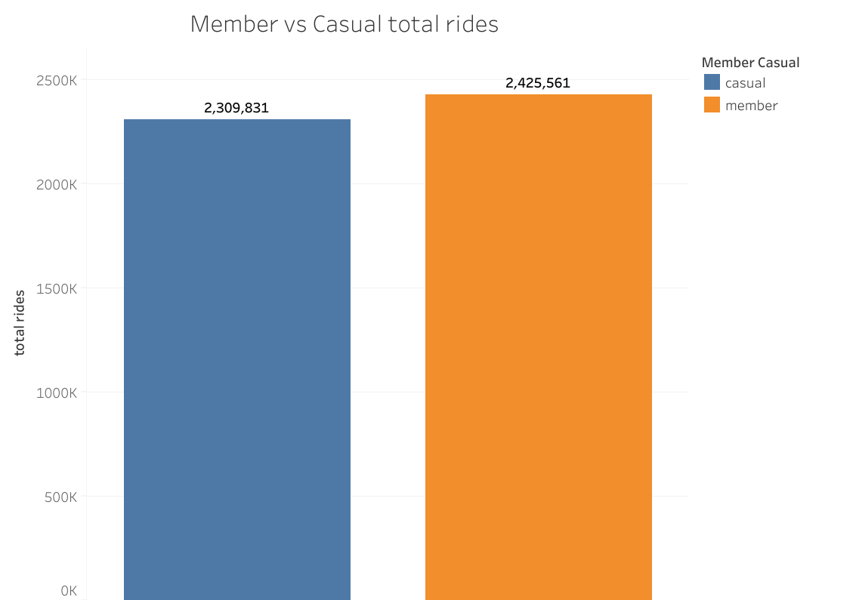
Casual riders are 115k less than member

Slide 4
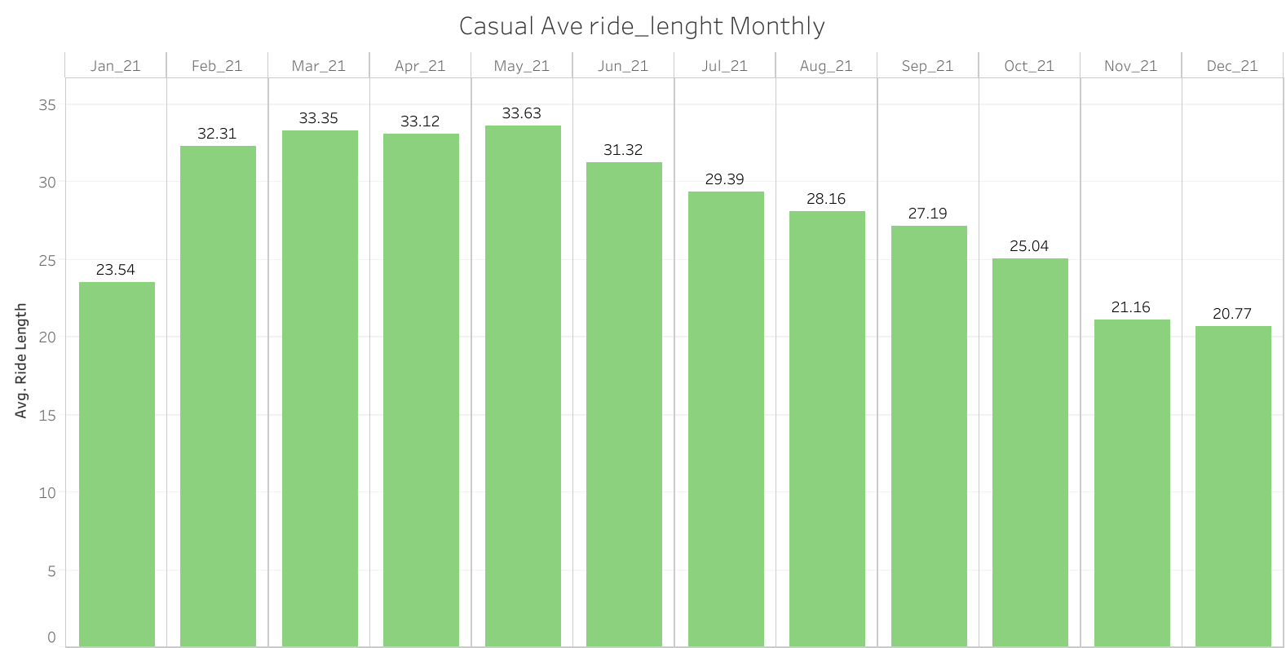
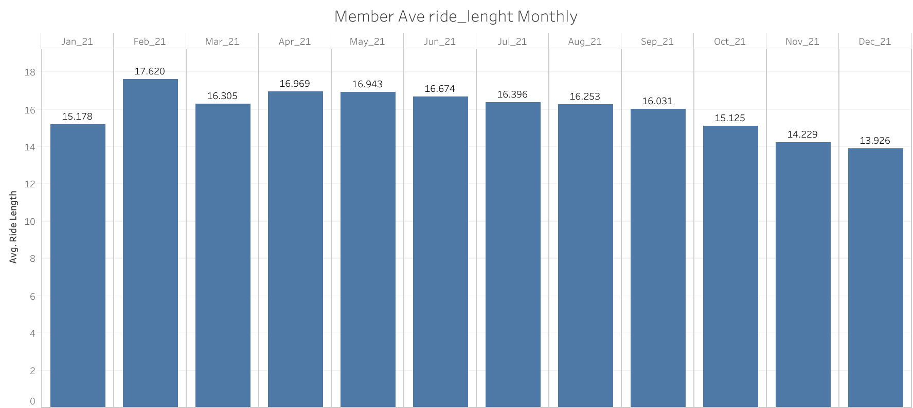
Casual riders trips are longer than members monthly

Slide 5
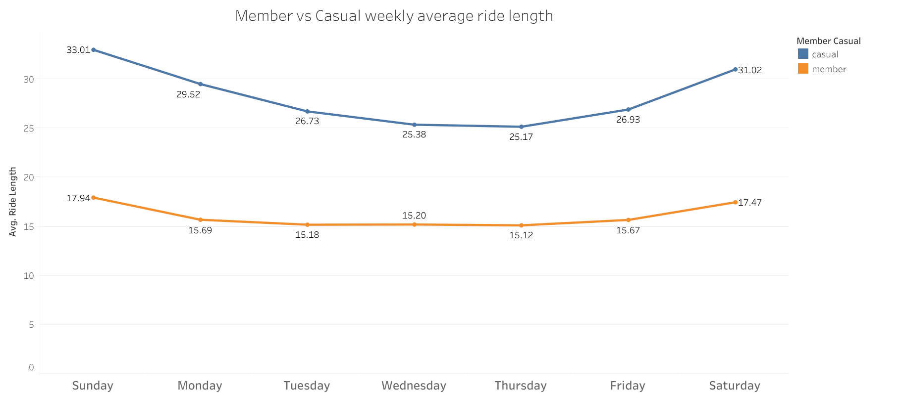
Casual riders trips are longer than members daily

Slide 6
recommendations
Make membership price cheaper to casual riders that use a bike for 20 or more minutes.
Increase prices on weekends for single rides

Slide 7
Questions

Slide 8
Thanks!

